Slide 1


Congresos 2024
Semillero IA

Slide 2
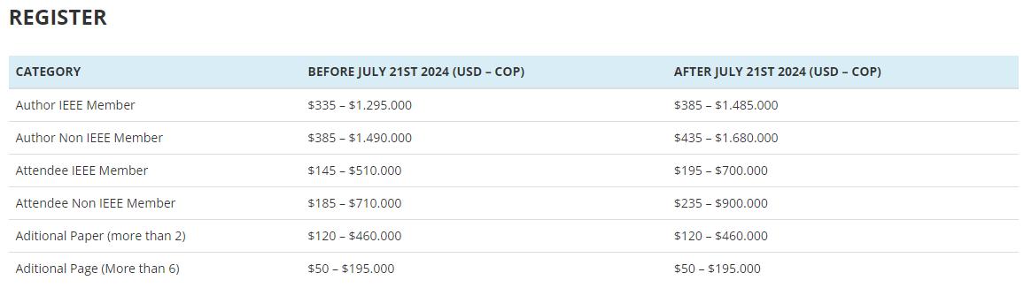
17th IEEE Colombian Conference on Communications and Computing – COLCOM 2024
Mode: Hybrid (Presential and Virtual)
Submission: May 17th 2024
Event date: August 21th to 23th 2024
https://2024.ieee-colcom.org/call-for-papers/#1708487348615-69032323-f3d3
Barranquilla – Colombia
In order to be published in the conference proceedings (IEEE Xplore database, including ISBN), accepted papers must be presented in oral sessions during the conference.

Slide 3
IEEE International Symposium on Technology and Society (ISTAS 2024)
Mode: Hybrid (Presential and Virtual)
Submission: May 24th 2024
Event date: September 18th to 20th 2024
https://attend.ieee.org/istas-2024/
Puebla - México
Accepted papers will be submitted for inclusion into IEEE Xplore Digital Library subject to meeting IEEE Xplore’s scope and quality requirements. All papers in IEEE Xplore are indexed to SCOPUS.

Slide 4
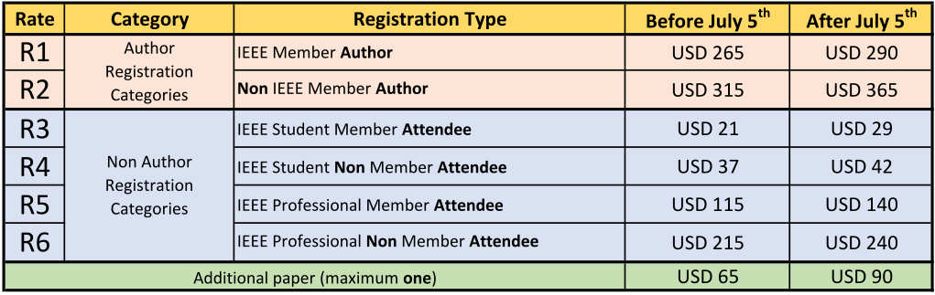
IEEE Colombian Conference on Applications of Computational Intelligence – ColCACI 2024
Mode: Presential
Submission: May 19th 2024
Event date: July 17th to 19th 2024
https://2024.ieee-colcaci.org
Pamplona - Colombia
We hope that local academy and industry will take active participation in ColCACI 2024. Papers will be reviewed by an international technical committee under the IEEE standard procedure and accepted papers must be presented in oral session. This process is mandatory for the paper to be published in the conference proceedings (IEEE Xplore database, including ISBN).

Slide 5
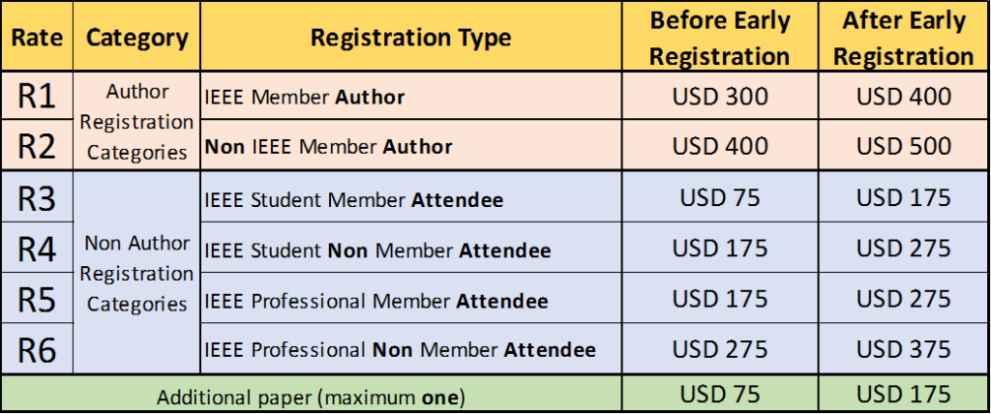
Latin America Conference on Computational Intelligence 2024
Mode: Presential
Submission: April 20th 2024
Event date: November 13th to 15th 2024
https://ieee.org.co/la-cci2024/manifesto/
Bogotá - Colombia
Details of the IEEE conference templates are provided here. IEEE strongly encourages the use of these conference manuscript templates. Failure to remove template text from your paper may result in your paper not being published.

Slide 6
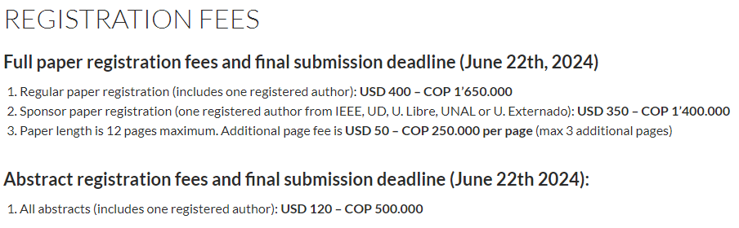
Workshop on Engineering Applications 2024
Mode: Hybrid (Presential and Virtual)
Submission: May 27th 2024
Event date: October 23th to 25th 2024
https://ieee.udistrital.edu.co/wea2024/
Barranquilla – Colombia
Selected WEA 2024 papers will be invited to send extended and improved versions into the Journal SN Computer Science of Springer-Nature (subject to acceptation of the extended/improved versions after review).

Slide 7
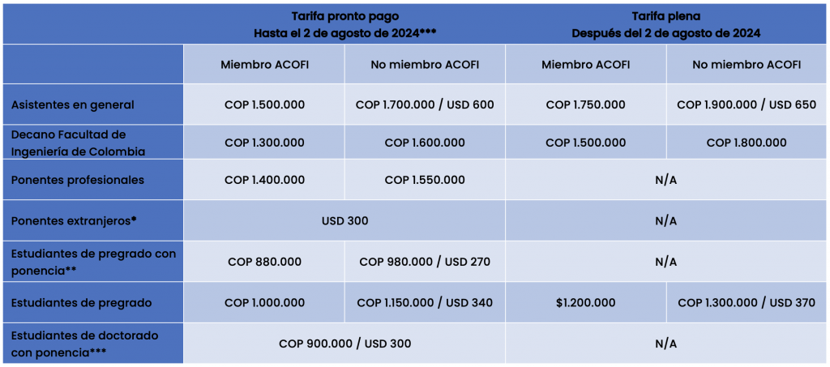
EIEI ACOFI 2024
Mode: Hybrid (Presential and Virtual)
Submission: April 12th 2024
Event date: September 24th to 27th 2024
https://acofi.edu.co/eiei2024/informacion-general/preinscripcion/
Cartagena – Colombia

Slide 8
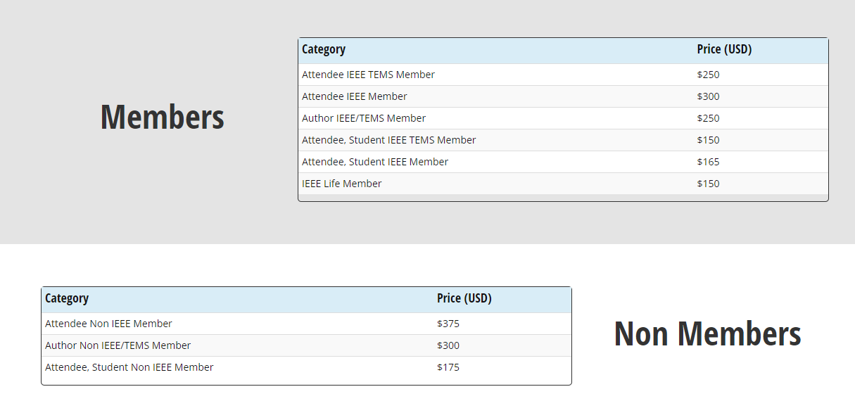
2024 IEEE Technology and Engineering Management Society Conference
Mode: Presential
Submission: April 30th 2024
Event date: July 17th to 19th 2024
https://attend.ieee.org/temscon-2024/
Ciudad de Panamá - Panamá
Conference proceedings that meet IEEE quality review standards may be eligible for inclusion in the IEEE Xplore® Digital Library. IEEE sponsorship of any kind does not guarantee that papers accepted for presentation at the conference will be eligible for publication in the IEEE Xplore® Digital Library.

Slide 9
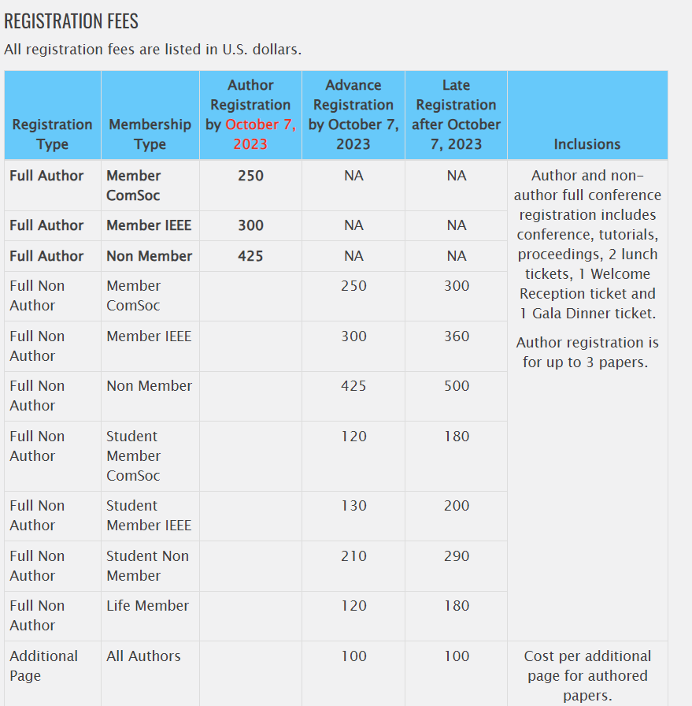
IEEE Latin-American Conference on Communications
Mode: Presential
Submission: July 8th 2024
Event date: November 6th to 8th 2024
https://latincom2024.ieee-latincom.org
Medellín - Colombia
Accepted and presented papers will be published in the IEEE LATINCOM 2024 Conference Proceedings and submitted to IEEE Xplore as well as other Abstracting and Indexing (A&I) databases.

Slide 10
AIAA SciTech Forum and Exposition
Mode: Presential
Submission: May 23th 2024
Event date: January 6th to 10th 2025
https://www.aiaa.org/SciTech
Orlando – Estados Unidos de América

